Slide 1

SALES OVERVIEW

Slide 2
KEY POINTS
Total sales – 10 million dollars.
Average order - 33k.
Total Orders – 29 million

Slide 3
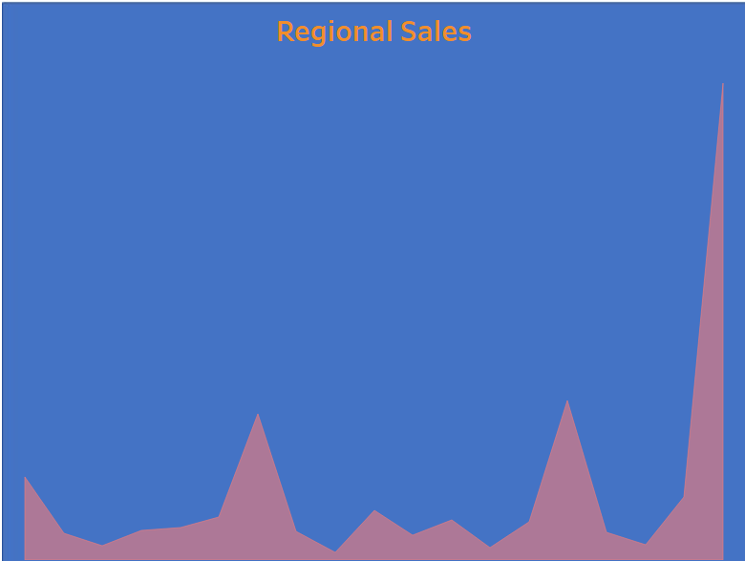
Regional Sales
Highest sales - USA

Slide 4
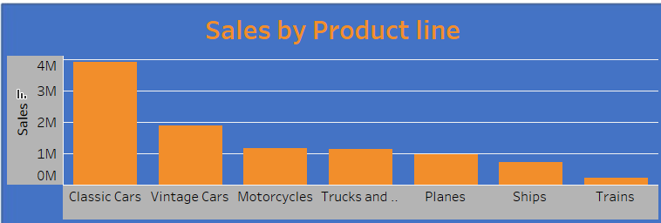
Sales by Product line

Slide 5
THANK YOU

